Slide 1
For internal use only. Not to be used with, or distributed to, the public.

Slide 2
Building A Family Legacy

Slide 3
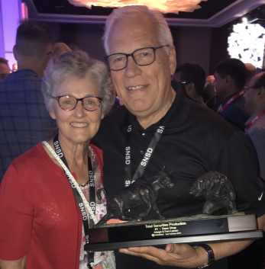
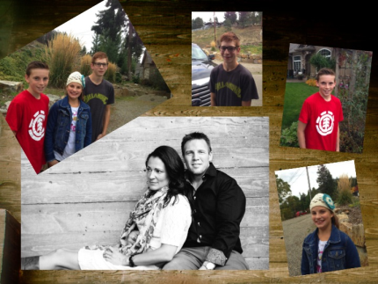
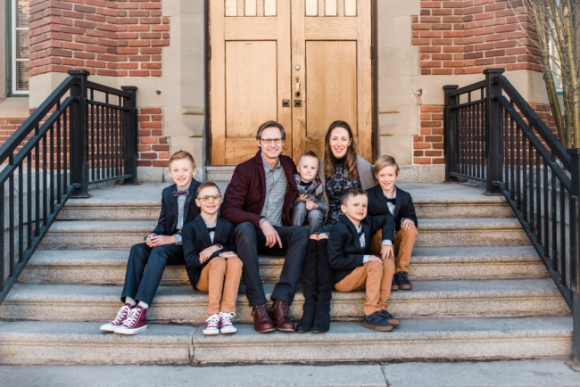
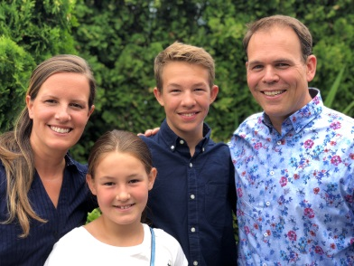
Building a Family Legacy
The best gift you can give your family….
A business that keeps on giving from generation to generation!

Slide 4
Building A Family Legacy
Our Family Story….
It all started with a $199 IBA! (1988)
Arleigh just wanted to make $50,000 - $100,000/yr.
Then came the fork in the road – Change or quit! (1991)
Starting focusing more on building than selling.
Brent went full into the business in 1997
Eldon, joined full time in 1998
Sherri and her husband Garth, started full time in 1999.
Primerica has delivered for us in a HUGE WAY and it will for you too!

Slide 5
Building A Family Legacy
build a Primerica Business
We need different products
continue to build their Primerica Business
Compliance is driving me crazy
No DSC ….I’m out
Auditors are too nosy
B2B is not approving my rrsp loans
Clients don’t believe me
Exams are too hard
Licensing takes too long
BC is hard…..Alberta is easy!
Traffic is killing me
Paperwork is out of control
Can’t do presigned forms any more
Commission income is not for me
My baseshop isn’t doing anything
My upline doesn’t understand where I’m at
Stock market is killing me
Family is not supporting me
Too many chargebacks
Business is not growing fast enough
I’m broke and need to get a job!
I’m not cut out for this – too much self doubt
Arleigh had 7 RVP’s quit in one year!
Licensing fees keep increasing
I’m in the wrong hierarchy/baseshop
My upline doesn’t train me enough
I need to learn more before doing anything!
My Best Recruit Quit
Too much time away from my family
Too many dark houses
My guests didn’t show up to career overview meeting
$0

Slide 6
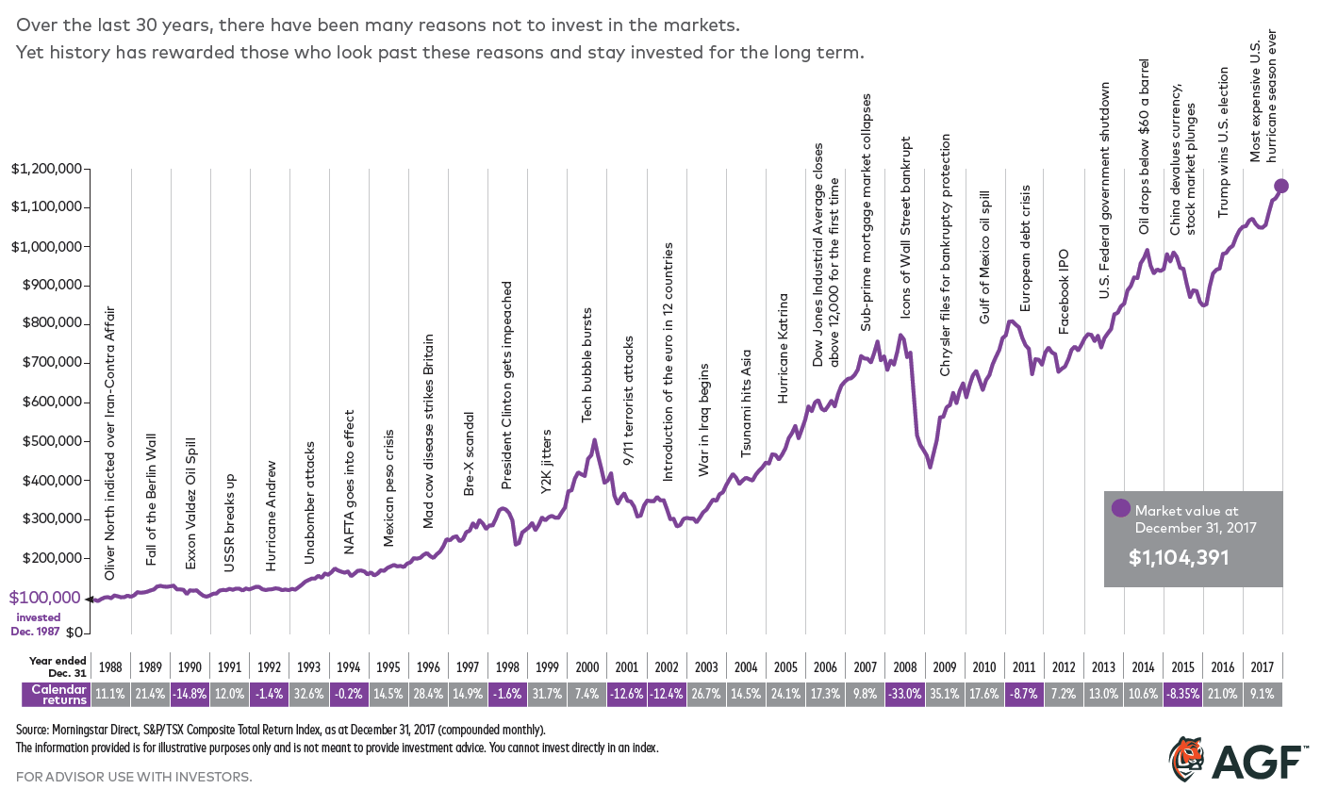
Building A Family Legacy
From 1996 – 2005 hierarchy codes averaged 485
2014 – 2018 licenses grew from 410 – 837
2005 – 2014 average licenses were 410 – Recurring income stayed fairly strong!
Just getting by and frustrated with slow growth
Grew hierarchy codes from 81 to 480
Grew codes from 485 - 620

Slide 7
Building a Family Legacy
Year 1
Year 30
Base shop 21
RVP’s 1
Licensed Hierarchy 21
Securities Licensed 19
1988 Premium sales $ 44,682
1988 Securities Sales $ 264,337
AUM Canadian $ 264,337
AUM US $ $ 0
Base shop 45
RVP’s 130
Licensed Hierarchy 2046
Securities Licensed 795
2018 Premium sales $ 4,051,356
2018 Securities Sales $ 310,933,249
AUM Canadian $ 2,002,835,083
AUM US $ $ 611,597,045

Slide 8
Building a Family Legacy
Hierarchy annual cash flow is now over $30 Million a year.
Family Annual Cash flow is now $2,310,386
What a difference a decision and $199 IBA has made for families around North America over the last 30 years.

Slide 9
Building A Family Legacy
What it takes:
Faith in the future of Primerica
Courage to stand out
Perseverance to withstand the tough times
Vision
Is your family buying into your DREAM or your NIGHTMARE?

Slide 10
Building A Family Legacy
Primerica will deliver !
Will you deliver for your family?
2019 is the year of

Slide 11
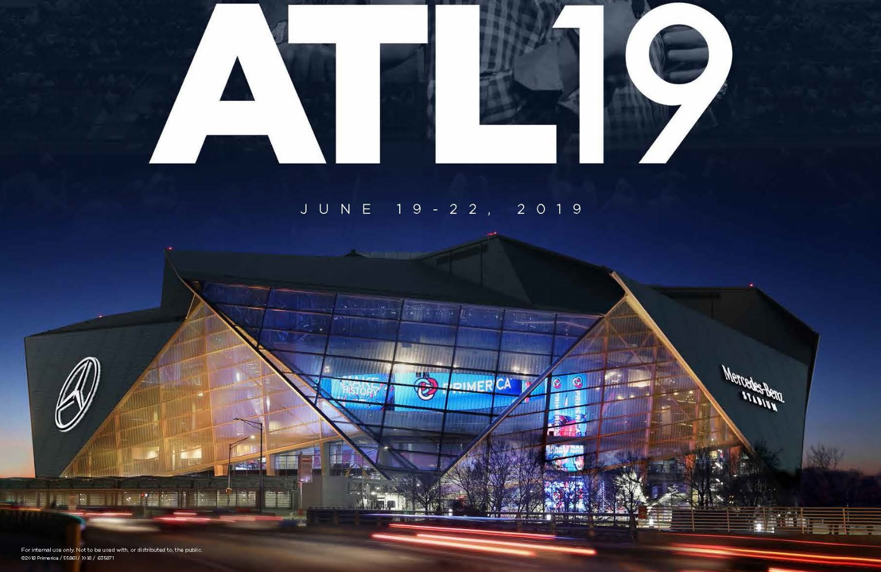
See you at the Mercedes-Benz Stadium in June!

